Slide 1
Credit Card Fraud Detection Model
Team #2
Michael Tran, Juan Gomez, Hamza Khamissa, Khilan Desai
Notes:
Khilan

Slide 2
Feature Engineering
Finding the relevant data to train on
Notes:
Khilan

Slide 3
New Features
Distance of Cardholder from Merchant
Age of Cardholder
Transaction Time
Fraud Rate in Cities
Fraud Rate in Jobs
History of Cardholder Fraud Experience
Notes:
Khilan

Slide 4
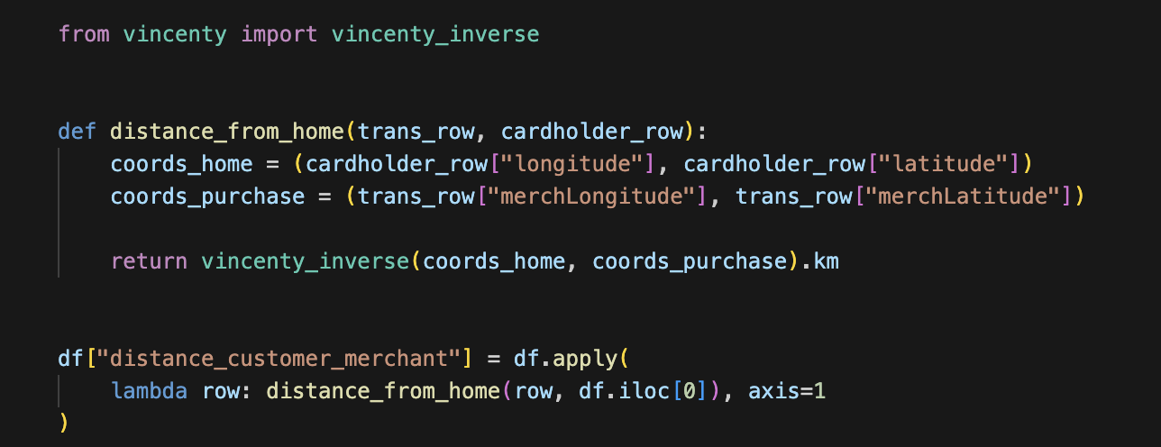
Distance From Cardholder to Merchant
Dropped:
latitude
longitude
merchLatitude
merchLongitude
Added:
distance_customer_merchant
The current features ‘latitude’, ‘longitude’, ‘merchLatitude’, and ‘merchLongitude’ alone do not provide relevant information.
We calculated the distance between and transformed into kilometers.
This allowed us to combine the four features into one measurement.
Notes:
Michael

Slide 5
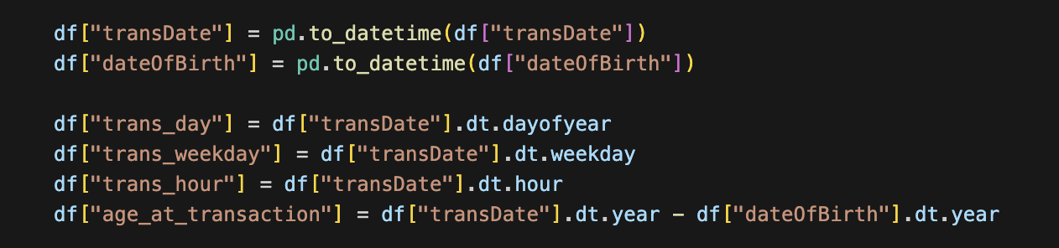
Age of Cardholder + Transaction Time
Dropped:
dateOfBirth
transDate
Added:
trans_day
trans_weekday
trans_hour
age_at_transaction
Using ‘dateOfBirth’ with ‘transDate’ we are able to calculate the age of the cardholder at the time of transaction.
We also broke down the `transDate` feature into three new features based on day of the year, weekday, and hour.
Notes:
Juan

Slide 6
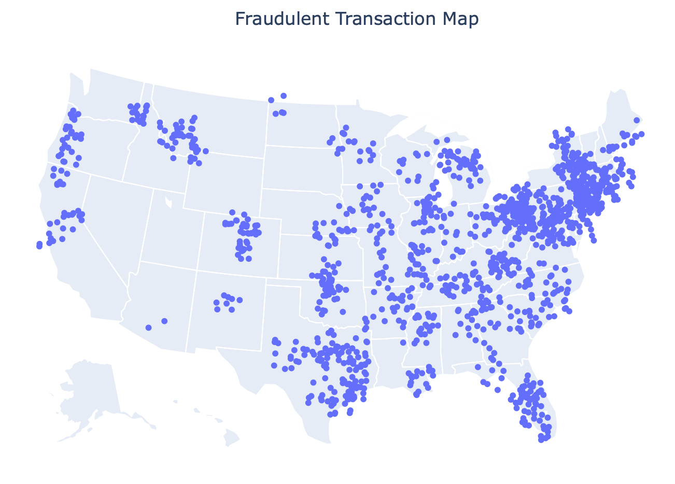
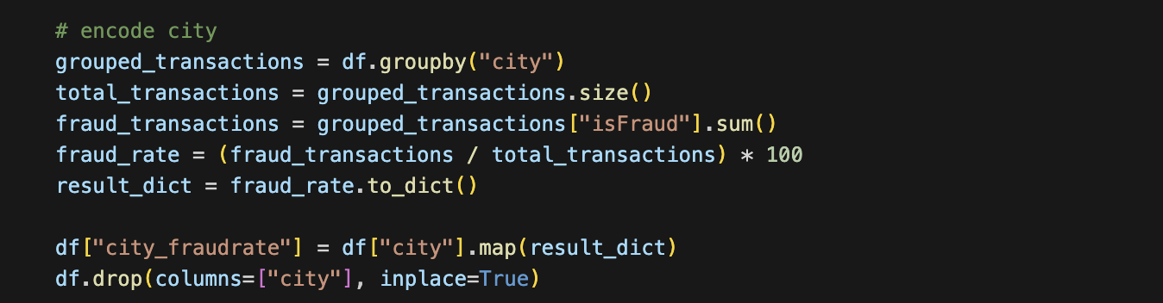
Fraud Rate in Cities
We computed city_fraudrate as a measure of fraud rates in a given city.
In the figure, you can see that fraud cases are clustered into higher density areas that are more likely to experience fraud.
Dropped:
city
Added:
city_fraudrate
Notes:
Michael

Slide 7
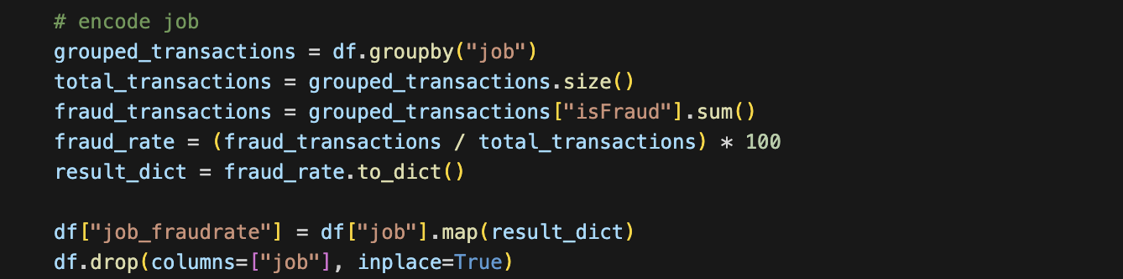
Fraud Rate in Jobs
Dropped:
job
Added:
job_fraudrate
Similarly ‘job_fraudrate’ was created to test for correlation in different industries.
Notes:
Michael

Slide 8
Categorical Variables
We want to encode these categorical variables into numerical values for the model.
Cardholder City
Cardholder Job
Purchase Category
The city in which the cardholder is located.
Some cities may experience higher rates of fraud, and thus purchases may have higher chances of being fraudulent.
The occupation in which the cardholder is employed.
Some jobs may experience higher risks of fraud due to the exposure or nature of their work.
The category of the purchase.
Certain goods and services are more prone to being fraudulent, or are more attractive targets of fraud.
Notes:
Michael

Slide 9
Purchase Category
We decided to use one-hot encoding for this feature.
The lower number of factors for this feature allowed for a manageable number of new columns to be created.
Dropped:
category
Added:
category_entertainment
category_food_dining
category_gas_transport
category_grocery_net
category_grocery_pos
category_health_fitness
category_home
category_kids_pets
category_misc_pos
category_personal_care
category_shopping_net
category_shopping_pos
category_travel
Notes:
Khilan

Slide 10
Cardholder History of Fraud
According to a 2024 study by DeLiema et al, past financial fraud victimization has an effect on likelihood to experience repeat victimization.
This also affects age groups differently, such as ages 70 - 80 experiencing higher rates of repeat victimization.
‘historyOfFraud’ is a boolean feature we added to note if certain cardholders have experienced fraud previously.
Source:
DeLiema M, Langton L, Brannock D, Preble E. Fraud victimization across the lifespan: evidence on repeat victimization using perpetrator data. J Elder Abuse Negl. 2024 Feb 22:1-24. doi: 10.1080/08946566.2024.2321923. Epub ahead of print. PMID: 38389208.
Notes:
Michael

Slide 11
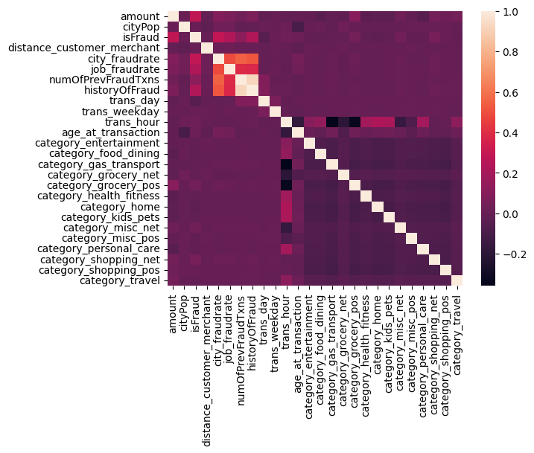
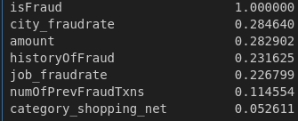
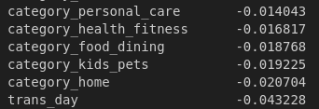
Correlation Matrix
Sorted Correlation Values to isFraud:
Notes:
Juan

Slide 12
Other Dropped Features
creditCardNum
business
firstName
lastName
gender
street
state
zip
transNum
These features were removed from the dataset.
They mostly comprise of identifying metadata and we found our initial exploratory data analysis did not find meaningful connections to fraud.
Notes:
Michael

Slide 13
Model Training and Evaluation
Evaluating our models for performance at fraud detection
Notes:
Juan

Slide 14
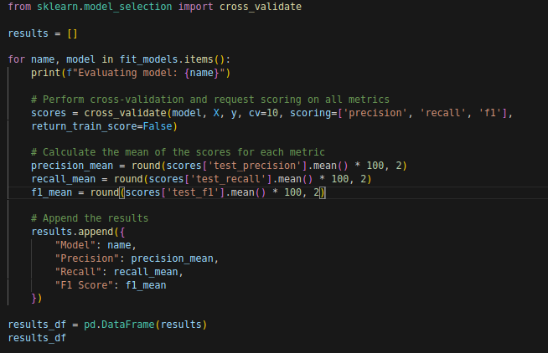
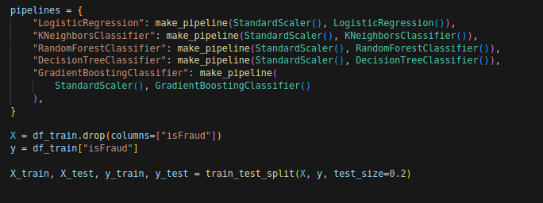
Choosing a model
LogisticRegression
KNeighborsClassifier
RandomForestClassifier
DecisionTreeClassifier
GradientBoostingClassifier
Notes:
Juan

Slide 15
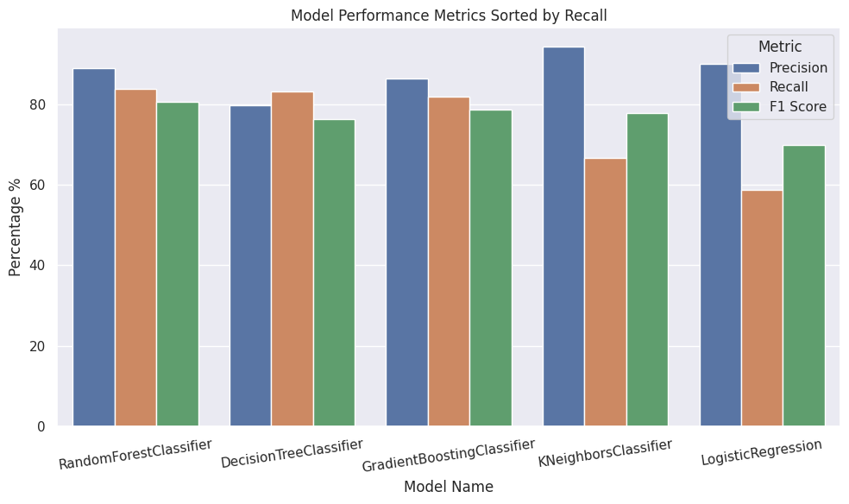
Models Comparison
When evaluating models, we valued Recall over Precision.
Our rationale is that in real-world fraud cases, all flagged cases would be reviewed, and thus we would rather have more false positives than false negatives in order to maximize detection.
We found that Random Forest had the best performance overall.
We worked with this model on hyperparameter optimization.
Notes:
Juan

Slide 16
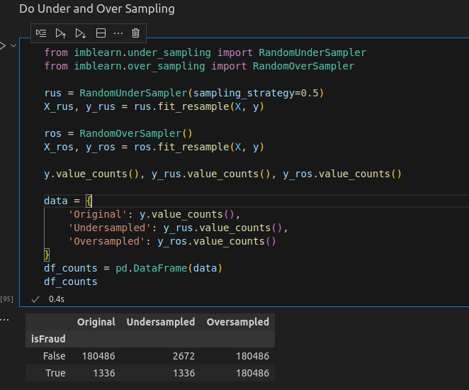
Undersampling, Oversampling
The dataset is very unbalanced:
Total number of transactions: 181822
Cases of fraud: 1336
Normal transactions: 180486
Percentage of fraud: 0.7348%
imbalanced-learn package in Python provides RandomUnderSampler and RandomOverSampler.
We found that using undersampling made the most sense, and also performed well.
Notes:
Khilan

Slide 17
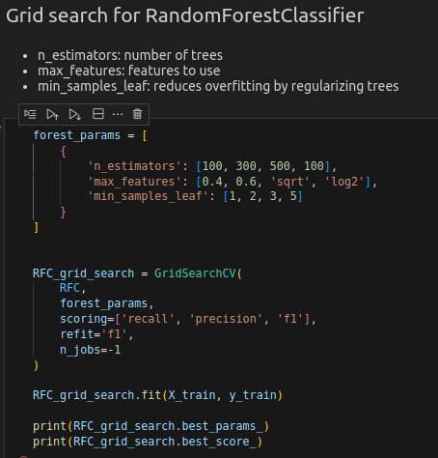
Hyperparameter Optimization
Using our Sklearn GridSearchCV we were able to increase our scores by finding the optimal Hyperparameters
Notes:
Khilan

Slide 18
Final Model Evaluation
98.63% Accuracy
97.76% Precision
98.13% Recall
97.94% F1 Score
Notes:
Khilan

Slide 19
Visualization
What does the data tell us

Slide 20
Feature Importance
city_fraudrate - 18.05%
historyOfFraud - 32.08%
amount - 28.43%
trans_hour - 7.22%
job_fraudrate - 5.73%
trans_day - 3.85%
category_gas_transport - 1.05%
distance_customer_merchant - 0.47%
age_at_transaction - 0.46%
cityPop - 0.41%
state - 0.38%
category_grocery_pos - 0.28%
category_food_dining - 0.28%
trans_weekday - 0.25%
category_home 0.19% category_shopping_net 0.15% category_shopping_pos 0.13% category_misc_pos 0.13% category_kids_pets 0.11% category_personal_care 0.10% category_grocery_net 0.09% category_health_fitness 0.07% category_travel 0.05% category_misc_net 0.02% category_entertainment 0.02%
Notes:
Hamza

Slide 21
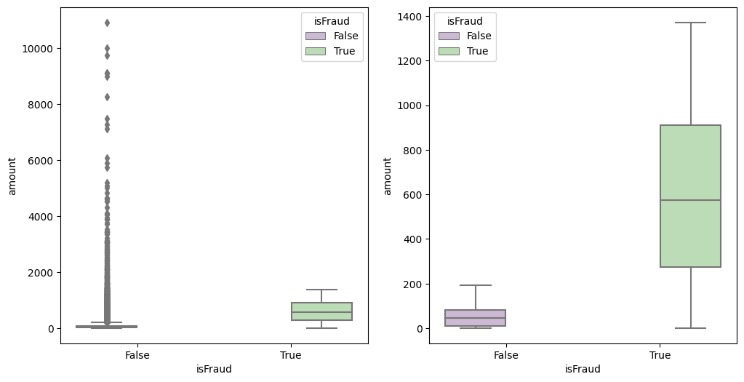
Purchase amounts with highest fraud rate
Notes:
Hamza

Slide 22
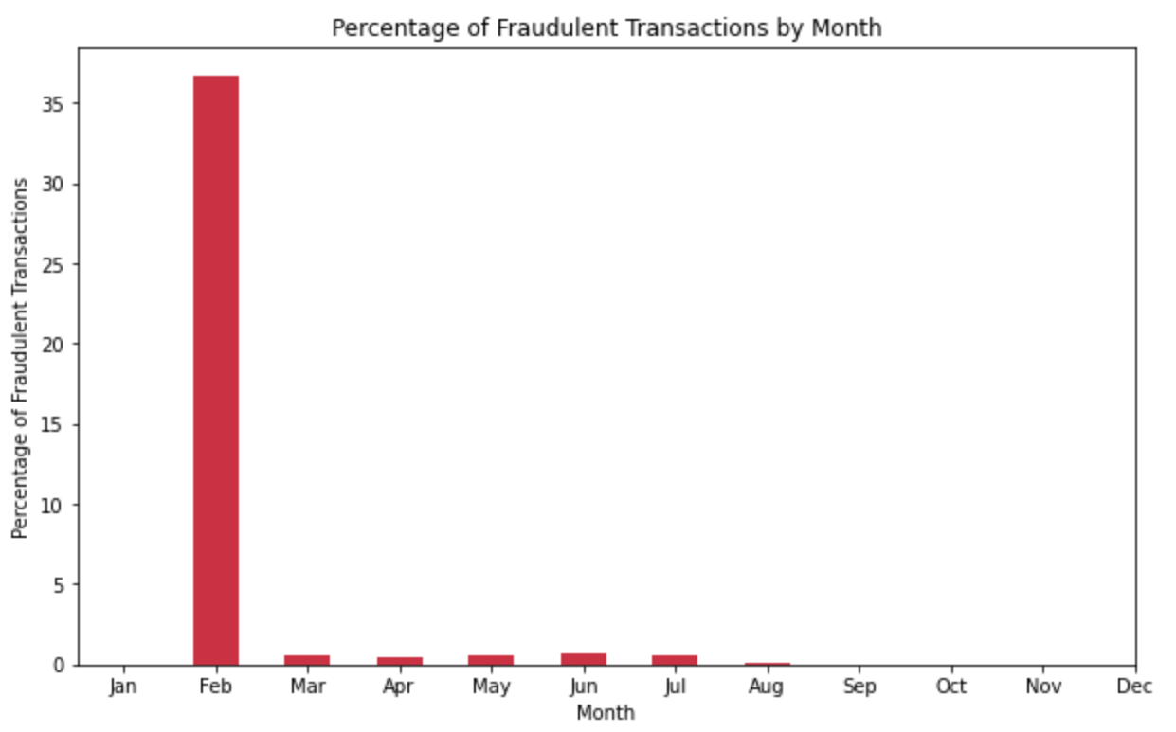
Percentage of Fraud by Month
Test for undersampling
Notes:
Hamza

Slide 23
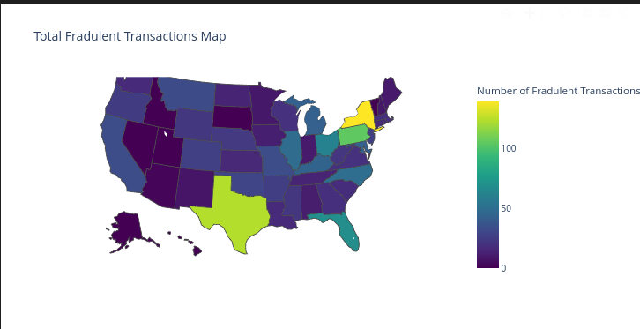
States with Highest Fraud Rate
Test for undersampling
Notes:
Hamza

Slide 24
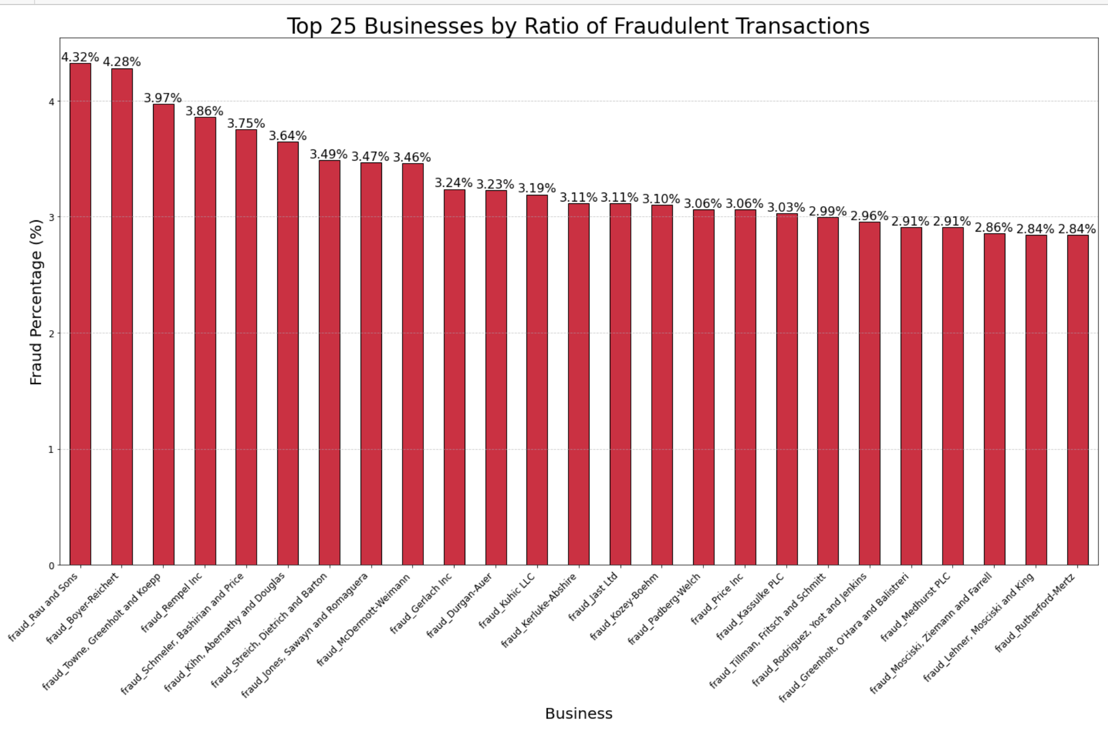
Top 25 Businesses for fraud
Test for undersampling
Notes:
Hamza

Slide 25
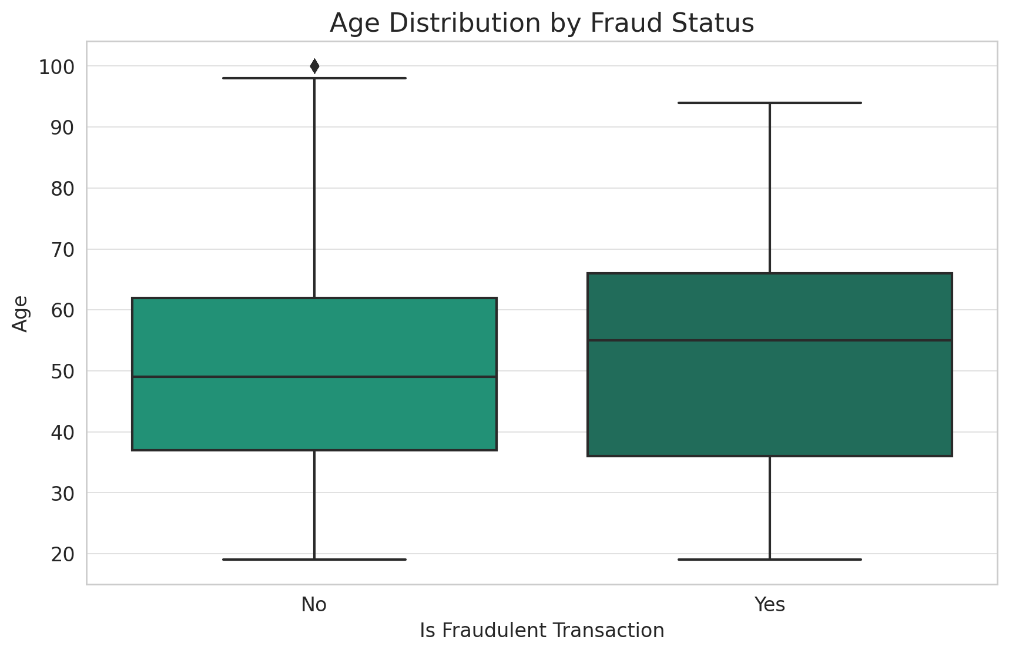
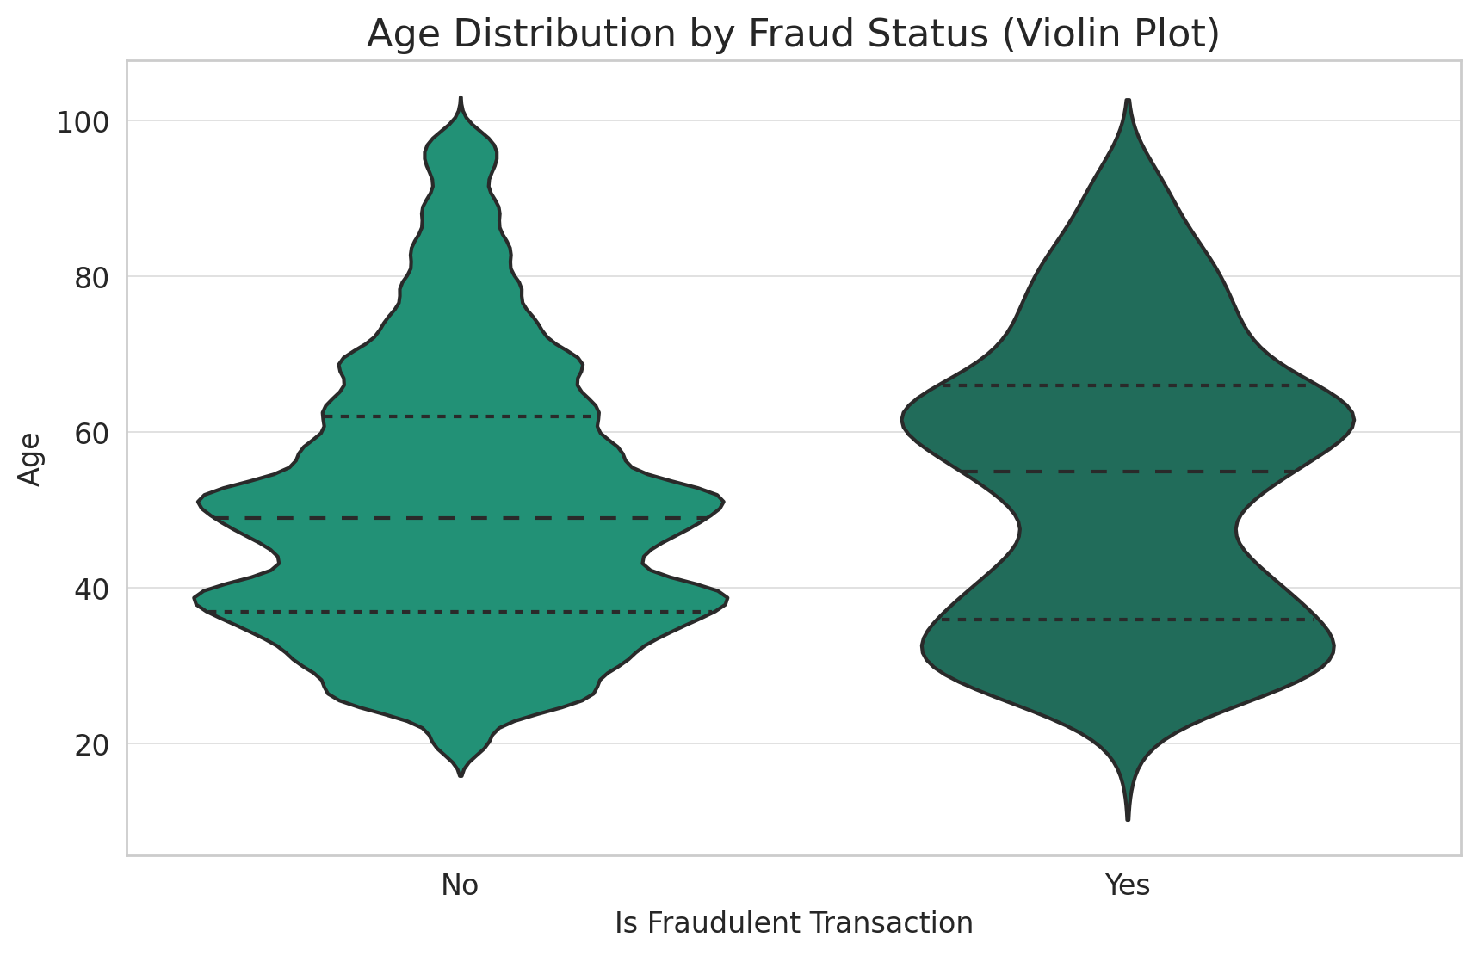
Ages with highest fraud rate
Notes:
Hamza

Slide 26
Most Likely Victim of Fraud
55 year old male
In a highly populated city
The purchase amount is above their average payment
The purchase was made at an odd time
Purchase was made far from cardholder
Purchase was made by a cardholder who has a history of fraud
Notes:
Hamza

Slide 27
Thank you!
Any Questions?
Notes:
Hamza

